Slide 1
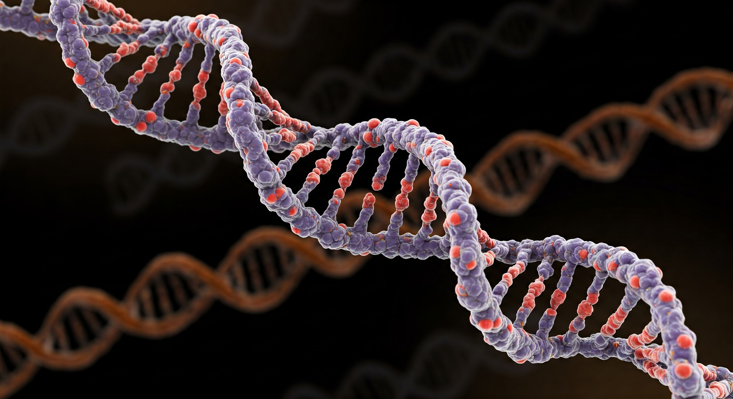
AI in Healthcare: High Risk Project Presentation
Genetic Markers of Critical Illness: Explainable Genomes using Statistical Analysis and LLMs
Jared Moore

Slide 2

Introduction
Explainable AI in Genetics

Slide 3
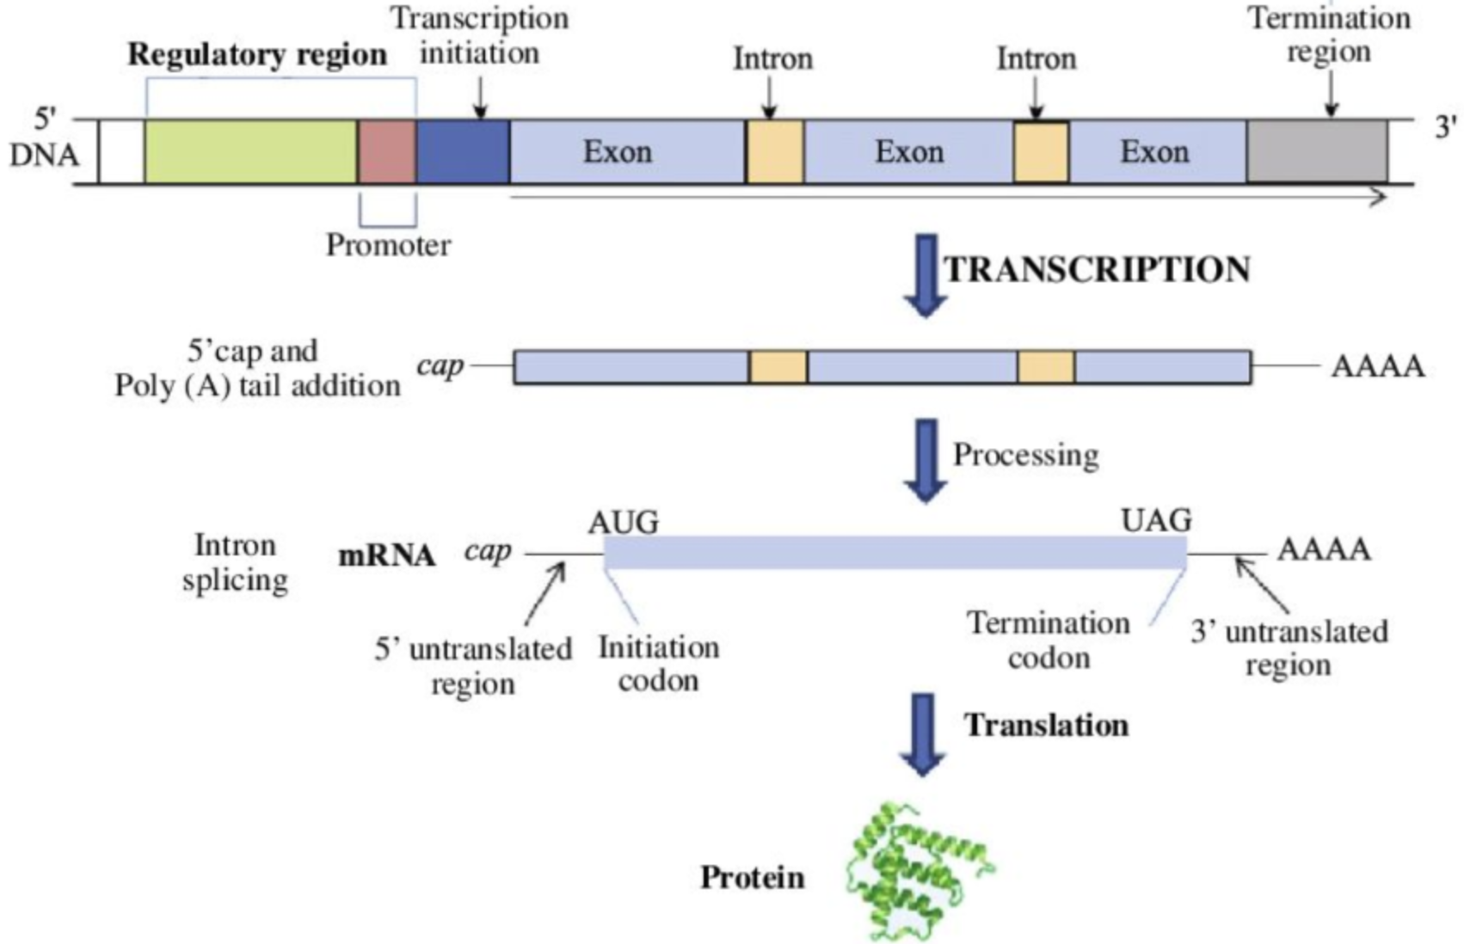
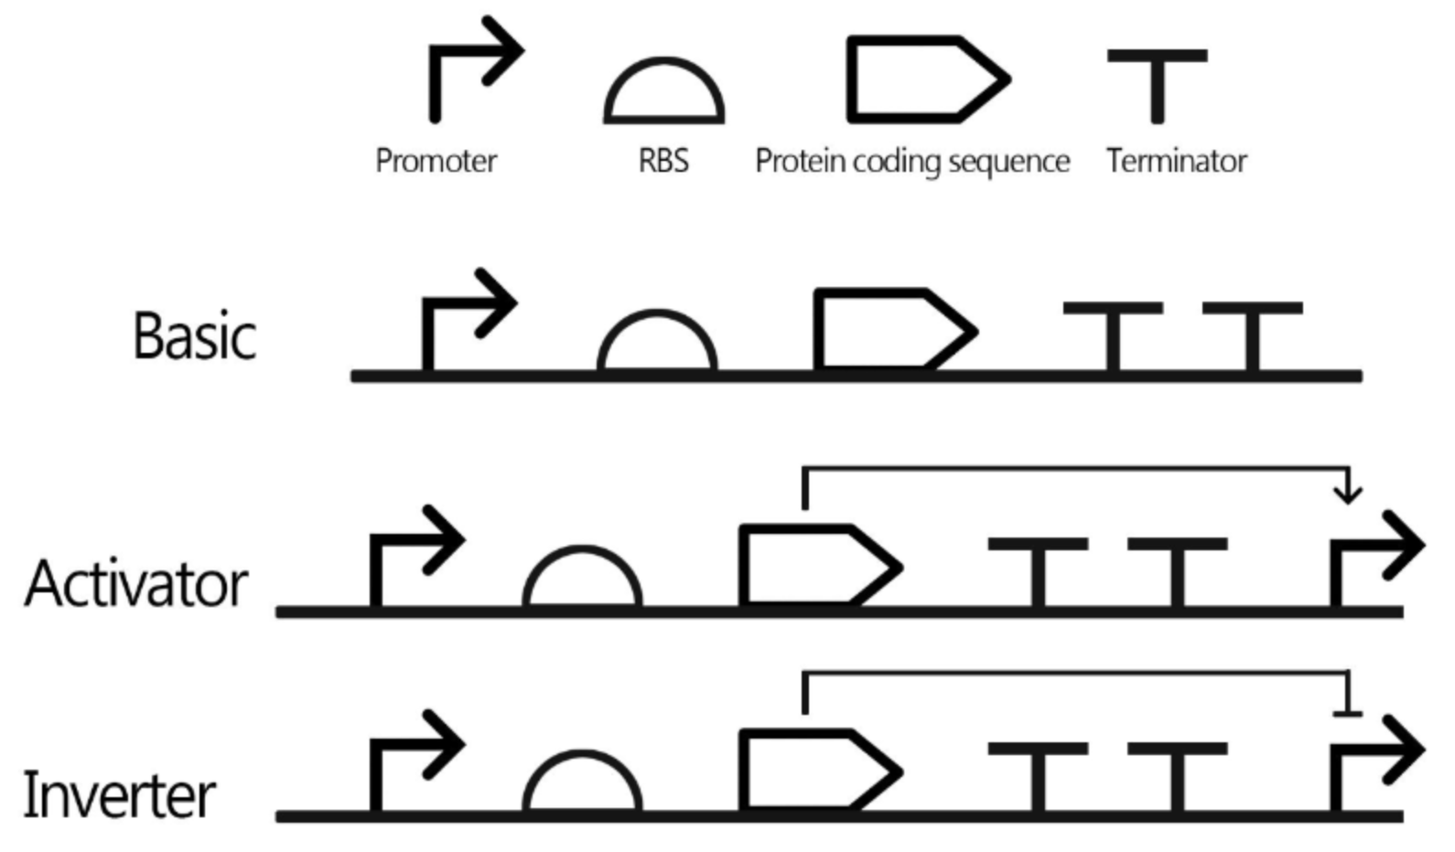
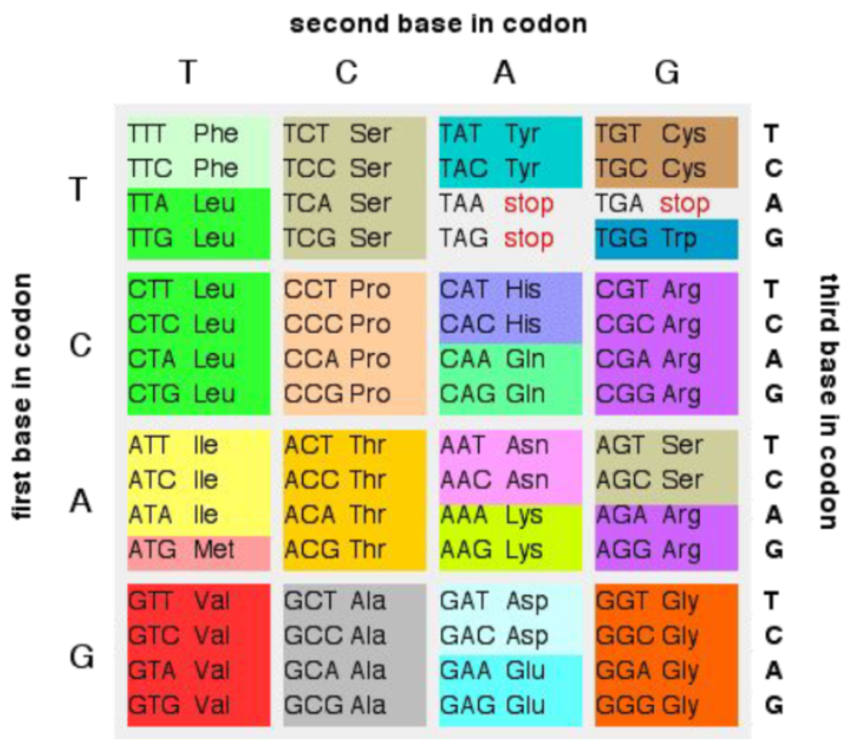
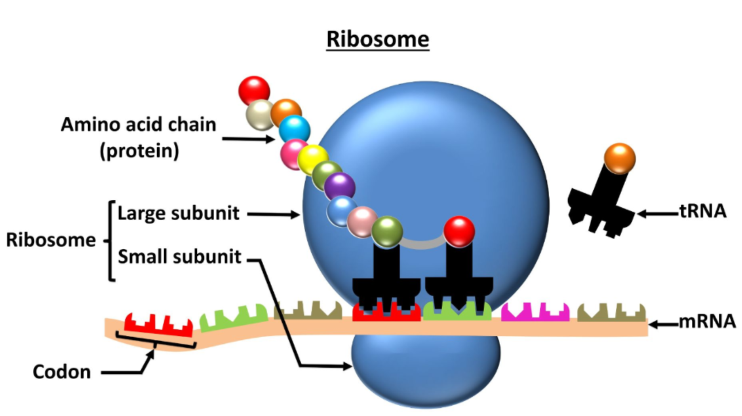
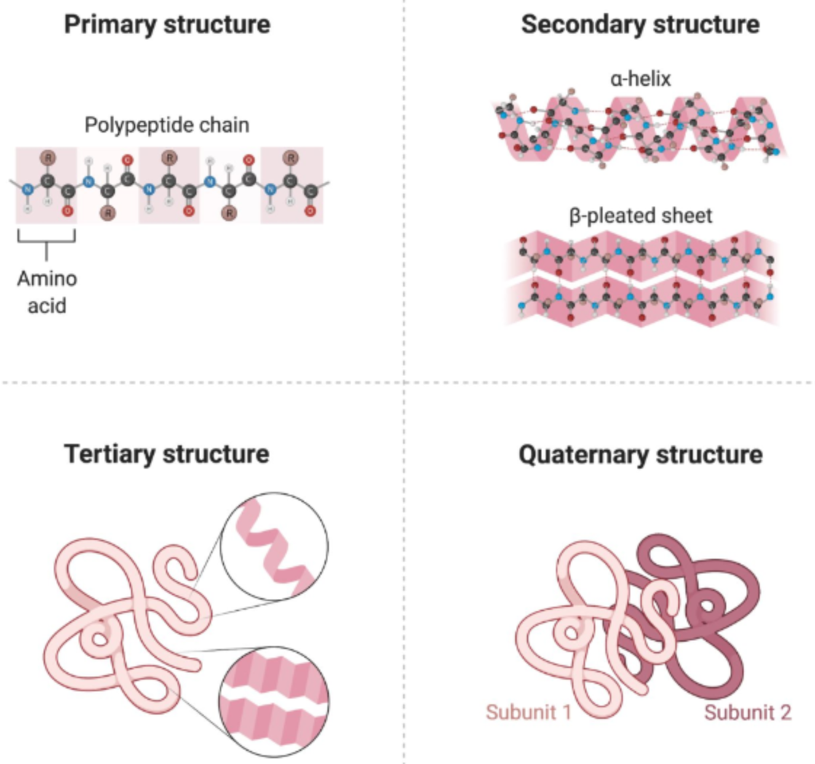
Challenges in Classifying Risks of Different Genes
Biology is really complicated
Genes are one part of a complex interplay between a variety of proteins, regulators, inhibition loops, and other aspects that are related to your final outcome
Biology can be difficult to explain
Most biology explanations are simple, but this is because of how little we truly understand about the complex mechanisms that are at work
Machine Learning presents opportunities to learn more about the effects of different genes, while LLM’s may provide enhanced capability for individualised patient recommendations based on personal genomic findings

Slide 4
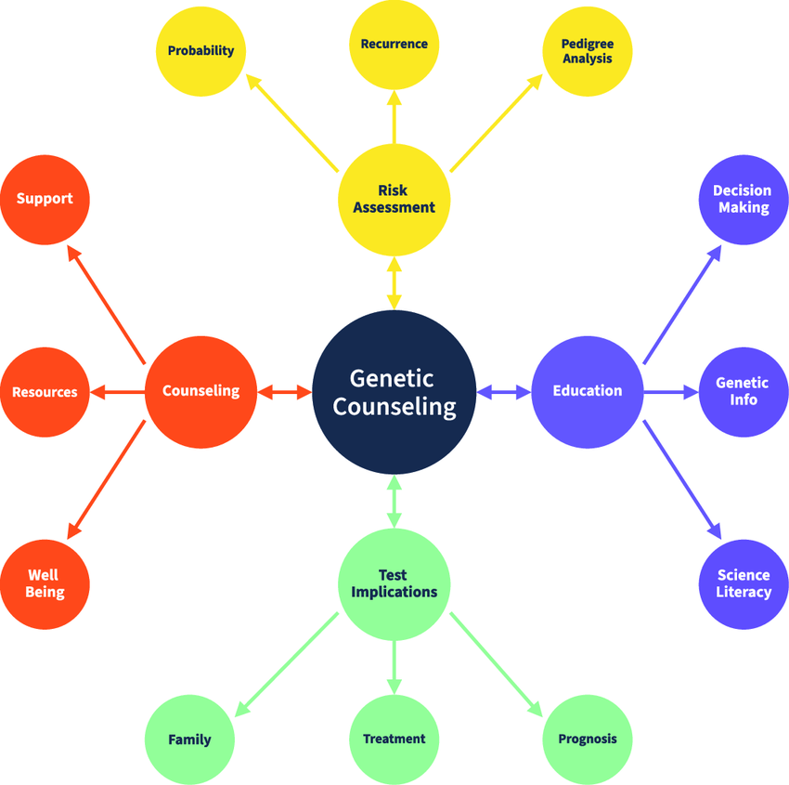
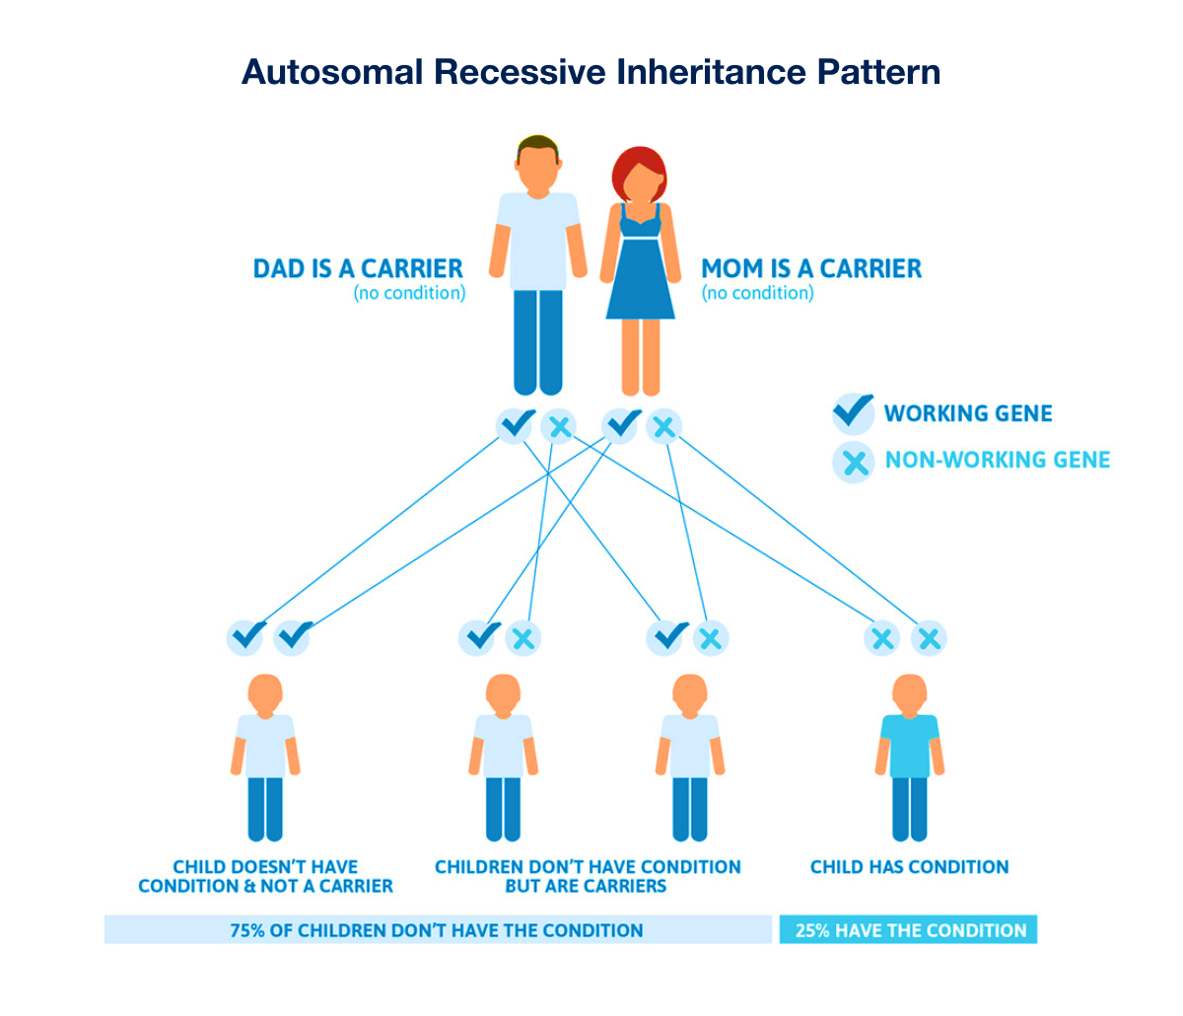
Conveying Genetic Medical information is challenging, even for Genetic Counseling Professionals
Genetic Counseling is already common for various medical needs, such as those of Expectant Parents, Children, and Adults testing for Hereditary Diseases
Genetic Counseling is often focused on well understood hereditary diseases, however Machine learning allows us to generate new insights which can be much more complex
Generative AI presents new opportunities to translate these complex insights directly to patients

Slide 5
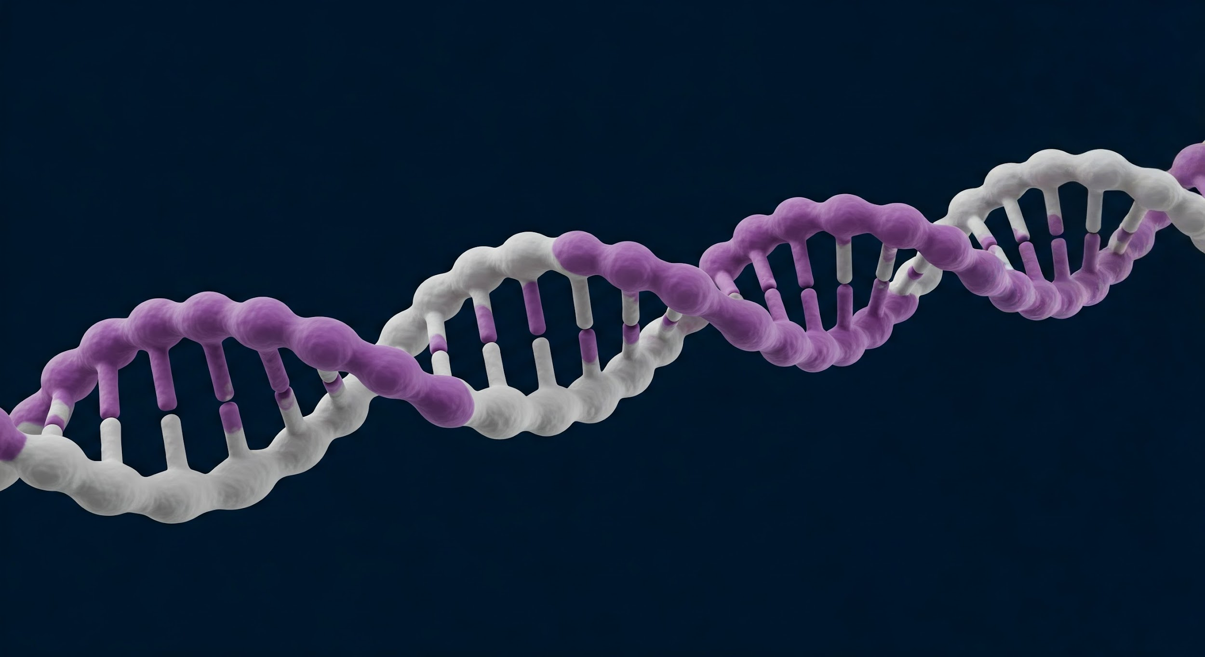
Methodology

Slide 6
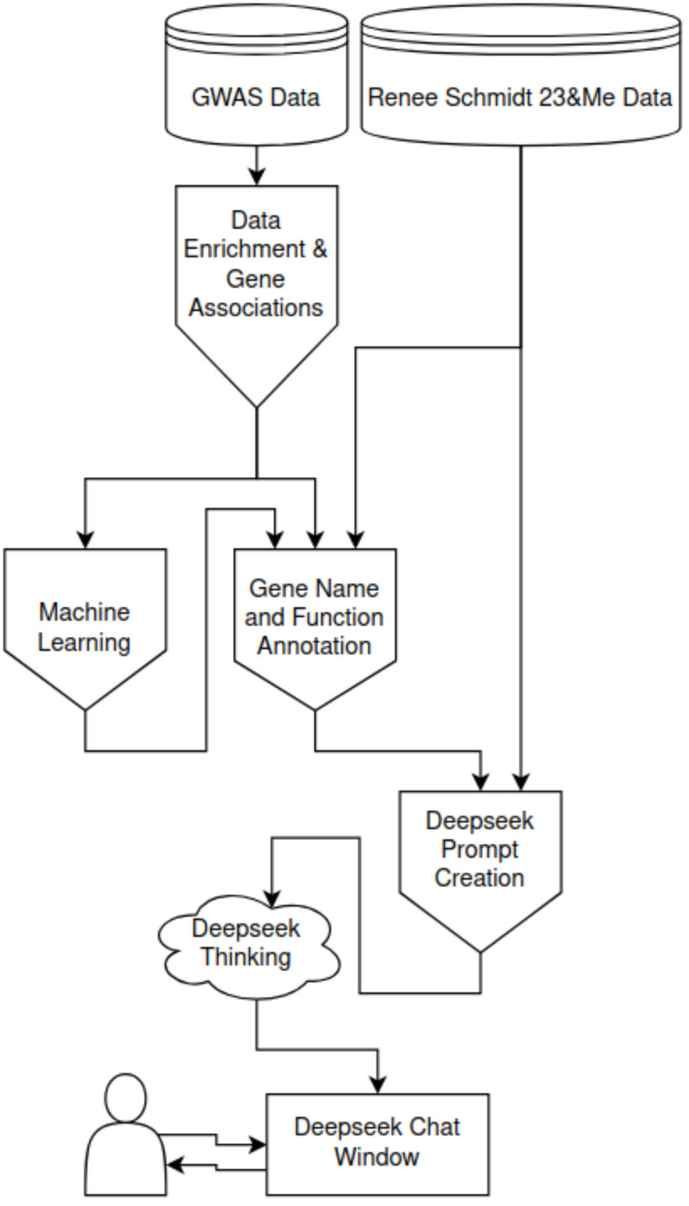
Research Approach
Identify genome-wide significant variants for COVID-19 severity
Develop a classification model for disease severity prediction
Annotate Genes with downstream effects to prompt Deepseek
Create an LLM-enhanced interpretation system for accessible explanations

Slide 7
Data & Methodology
GenOMICC international metadata release (COVID-19 GWAS)
Variant identification (p < 5×10^-8) and functional annotation
Anonymized Personal Genome from the Personal Genome Project Open Source Database (Alias “Renee Schmidt”)
Gene Mapping information from the GWAS Paper
LLM integration with DeepSeek R-1 for interpretable results

Slide 8
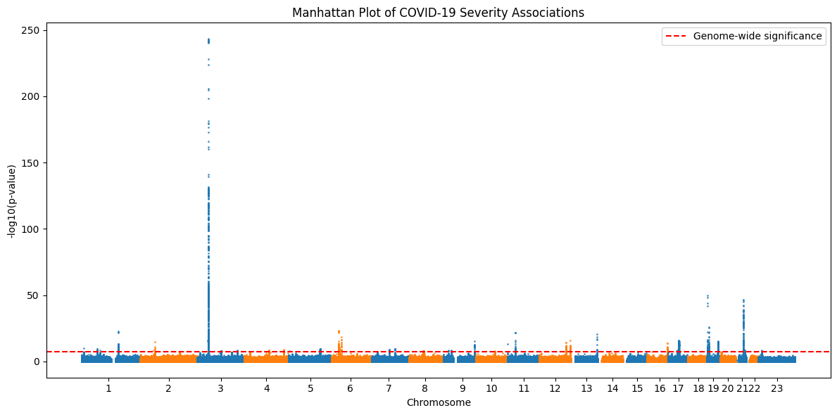
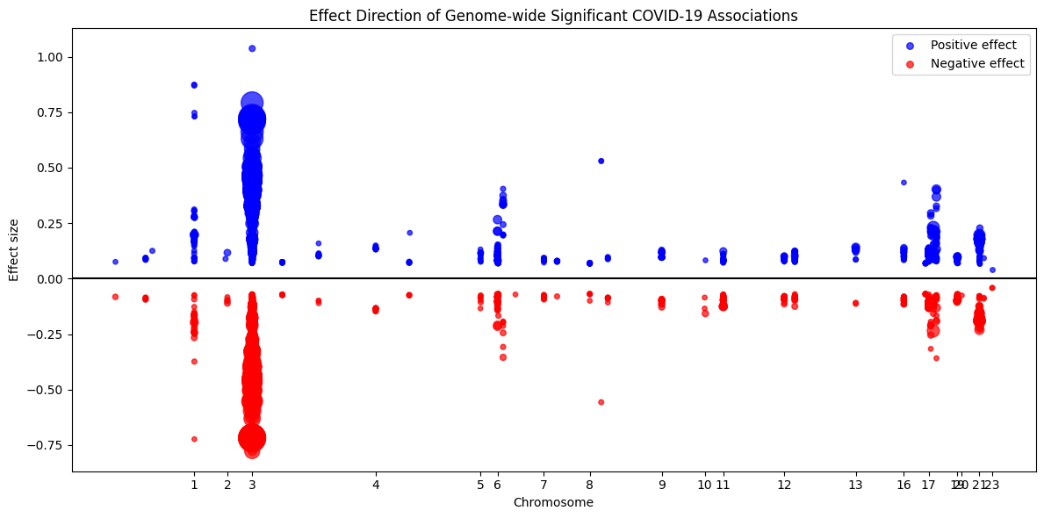
Population Statistical Analysis
4,864 significant variants identified across multiple chromosomes
Strong signals on chromosomes 3, 6, 19, and 21
Both risk-increasing and protective variants identified
Often have similar magnitude in similar areas
More often severity of effect is related to downstream function rather than the genes themselves

Slide 9
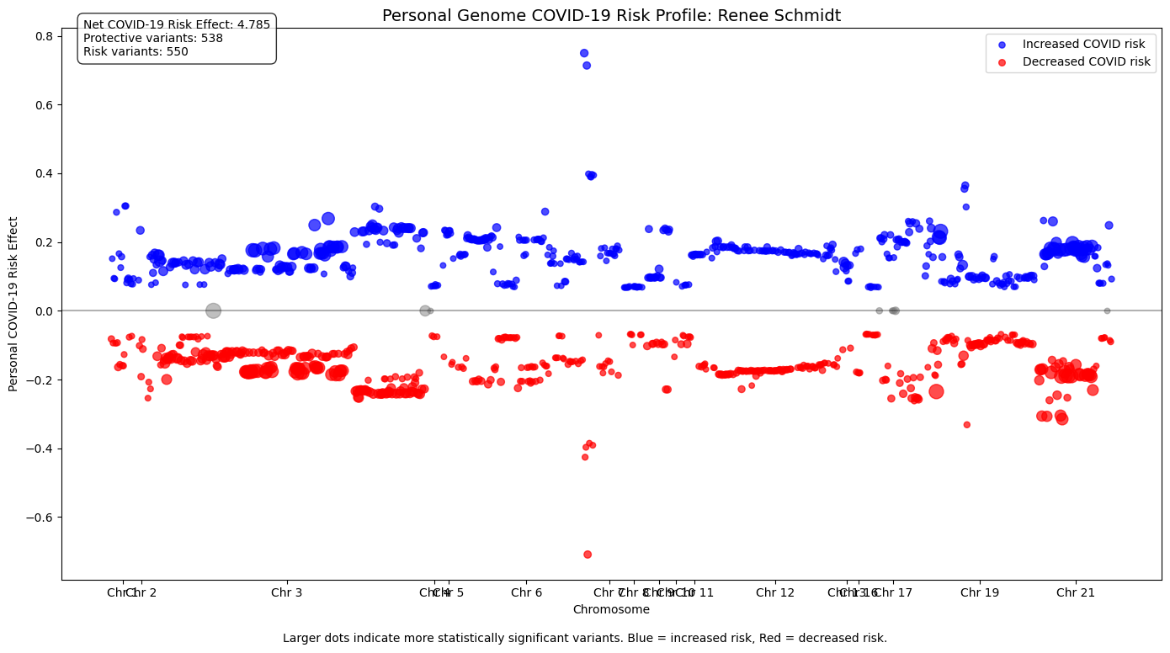
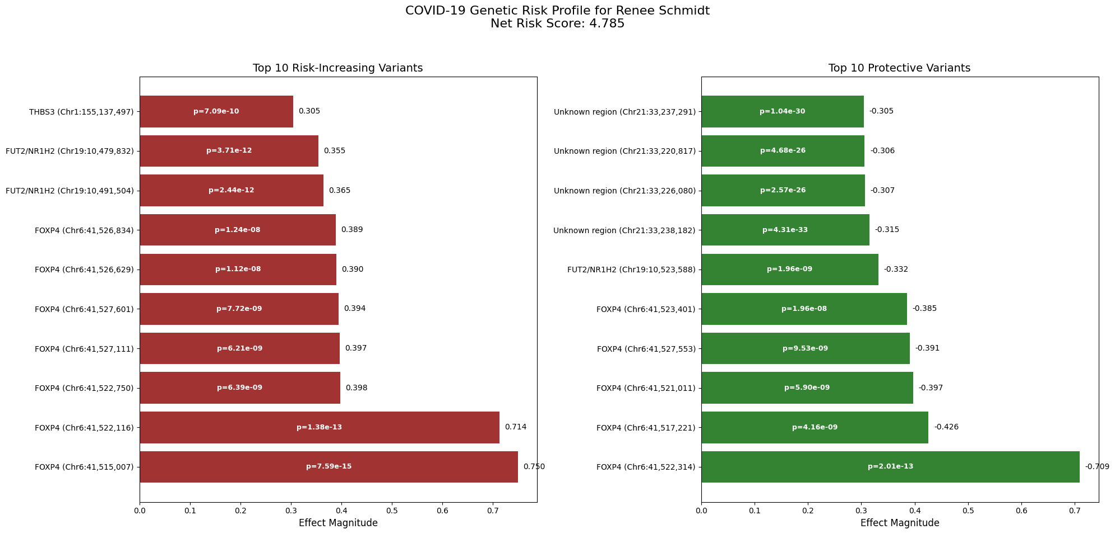
Personalized Risk Assessment
Sample case "Renee Schmidt": 1,088 variants (550 risk-increasing, 538 protective)
At first the symmetry between the positive and negative genes seemed confusing, however it is due to the functions the genes encode for and their importance to viral defense
Risky Gene Profile:
Top risk genes: FUT2/NR1H2, FOXP4, THBS3
Top protective genes: FOXP4, Unknown Regions
“Renee Schmidt” has a higher risk than the population due to some genes

Slide 10
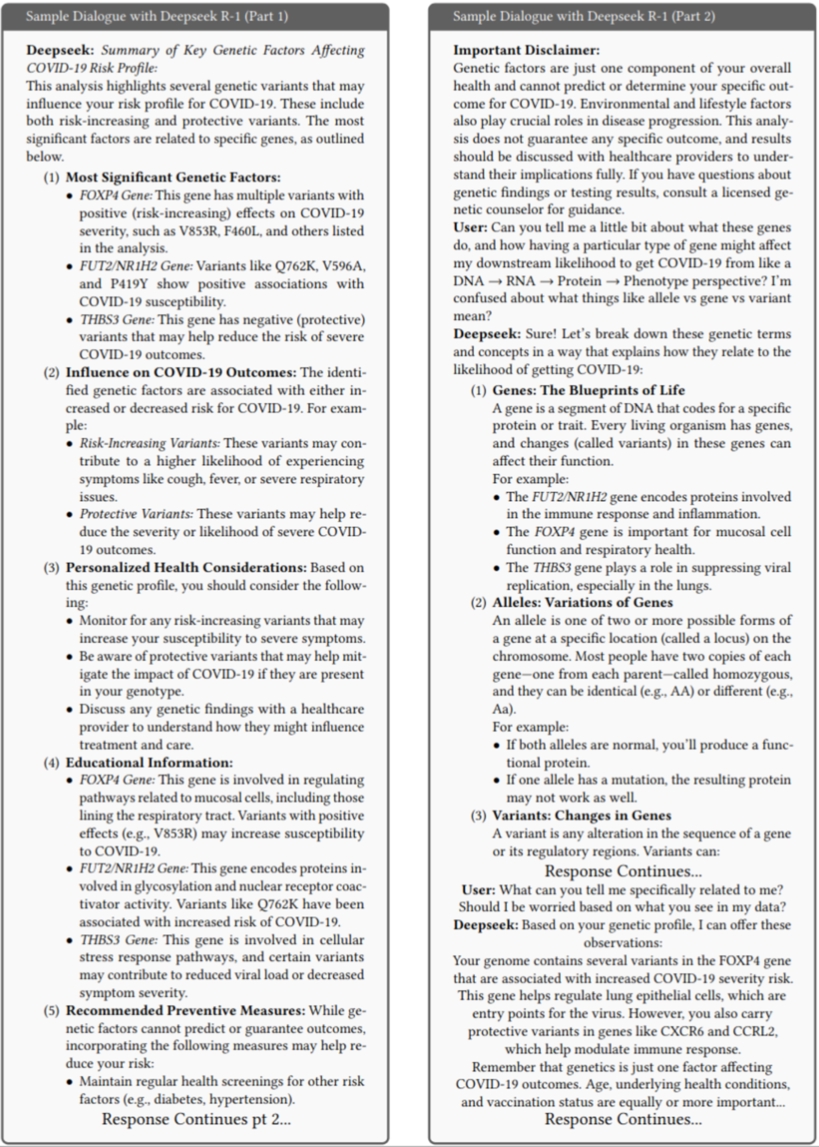
LLM Integration: Deepseek R-1
DeepSeek R-1 translates technical information into conversational explanations
System explains gene functions and COVID-19 pathophysiology
Maintains appropriate clinical boundaries with medical disclaimers

Slide 11

Results & Limitations

Slide 12
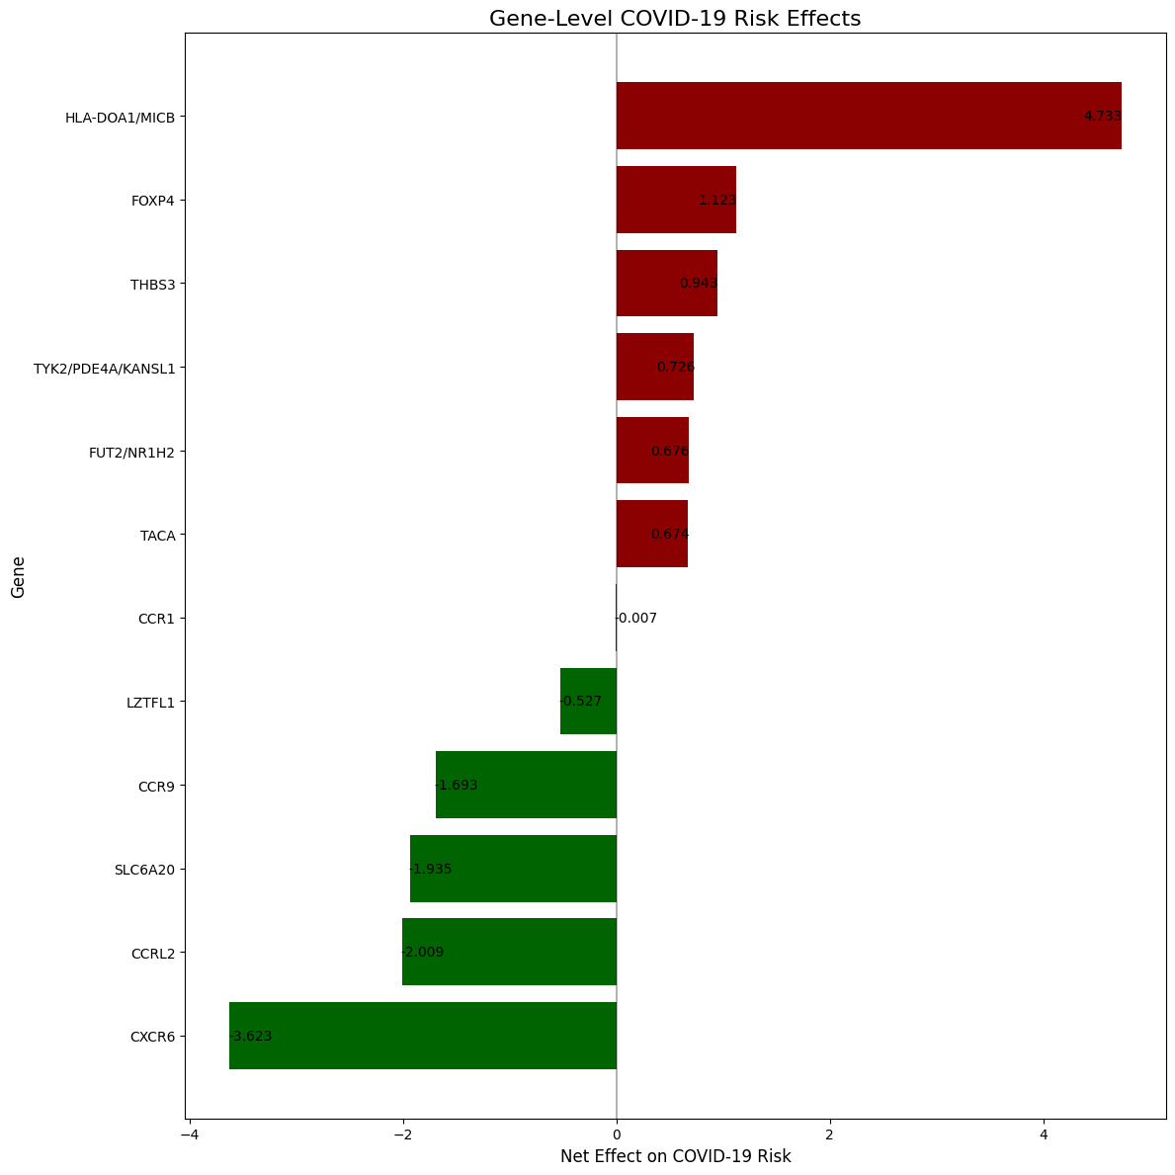
Key Results
Successfully identified genetic variants associated with COVID-19 severity
Demonstrated complex interplay of risk-increasing and protective variants
Created framework for translating genomic data into accessible explanations

Slide 13
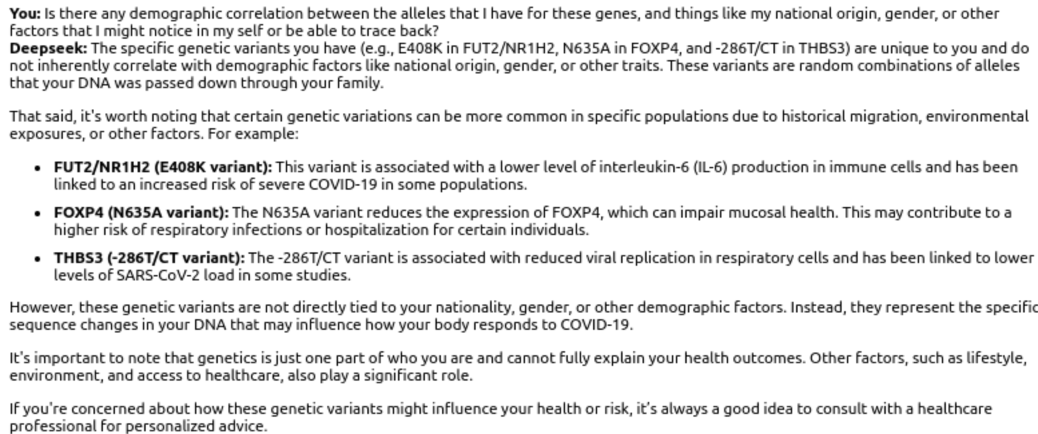
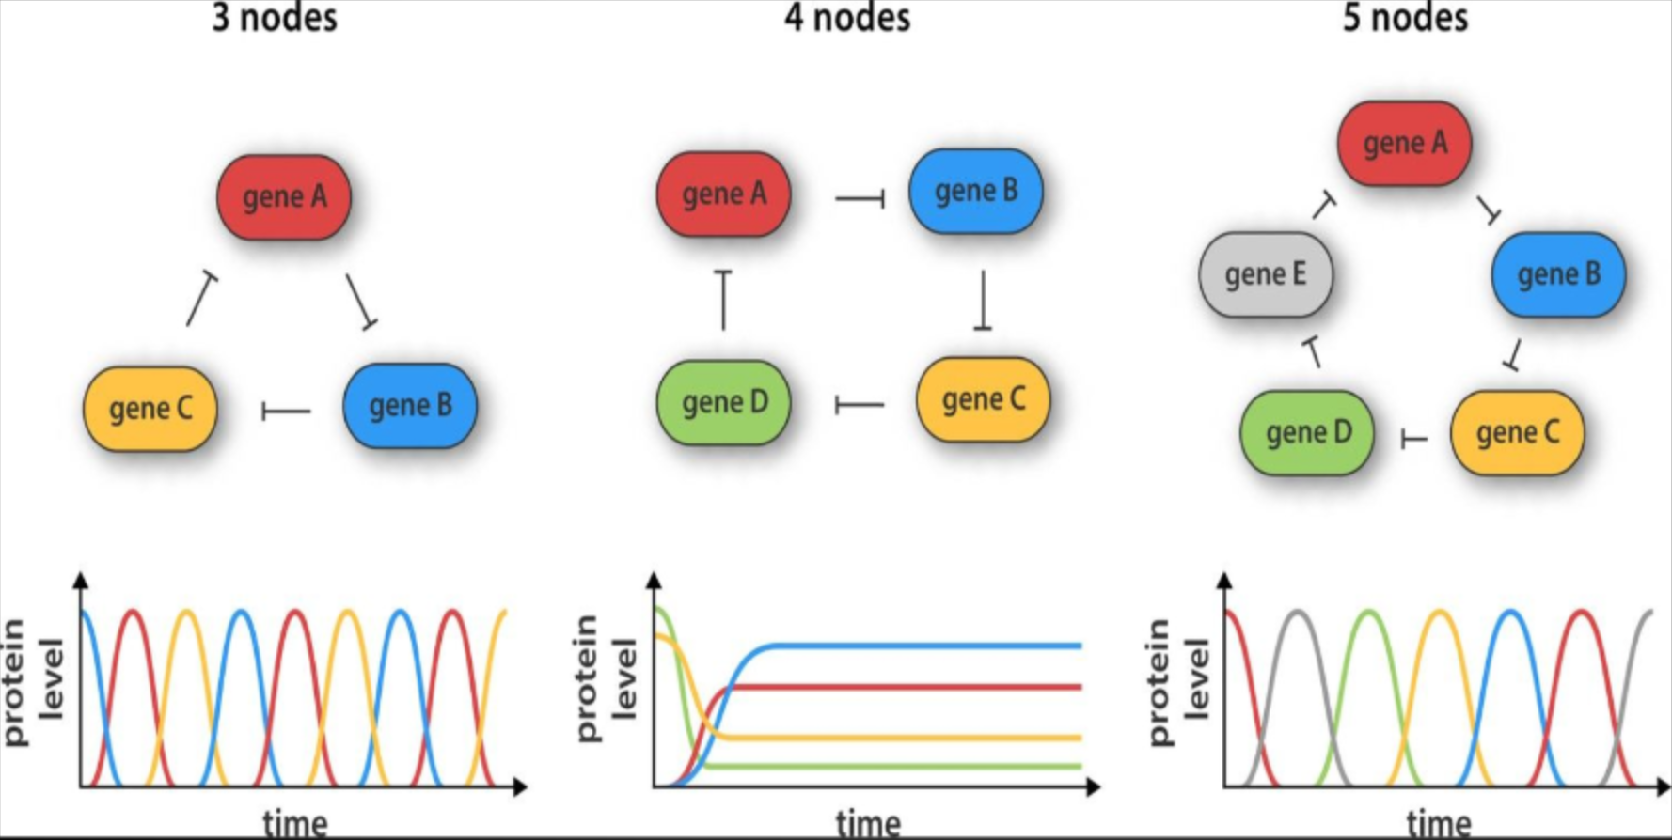
Limitations
Reliance on additive genetic model does not capture complex gene-gene interactions
Potential ancestral representation gaps in underlying GWAS data
Provides relative rather than absolute risk assessment
Does not have access to other Health related data, only genetics and statistics about them
LLM integration cannot replace clinical genetic counseling
Gene Repression Complex Interactions

Slide 14
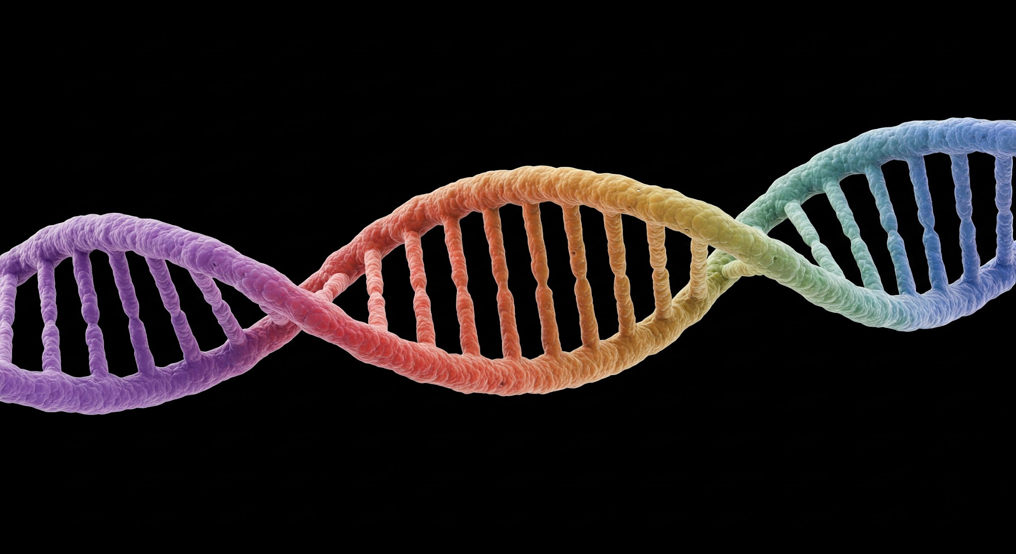
Future Directions

Slide 15
Future Directions
Integrate clinical variables with genetic markers
Expand to multi-omics analysis (transcriptomics, proteomics)
Understanding why certain alleles lead to positive or negative outcomes would lead to insights about genes relationship with cellular function at many different levels of biology
Conduct functional validation using cellular models
Data is a limiting factor for understanding how things like methylation and repression and expression signals affect the genes we have and when they are active
Extend methodology to other critical illnesses alongside COVID-19
Refine LLM capabilities for enhanced genomic interpretation
While Deepseek R1 shows promise for interpretable AI, more specialized models for biology may provide even more detailed results

Slide 16
Conclusion
Combined statistical genomics with explainable AI
Bridge between complex GWAS data and user-friendly LLM chat interfaces
Framework for responsible AI-assisted genomic interpretation, with diversions away from information it does not know or is not qualified to dispense
Project was an exciting way to explore a part of healthcare I was interested in, but had no experience in previously, and has the potential to be used in future applications

Slide 17
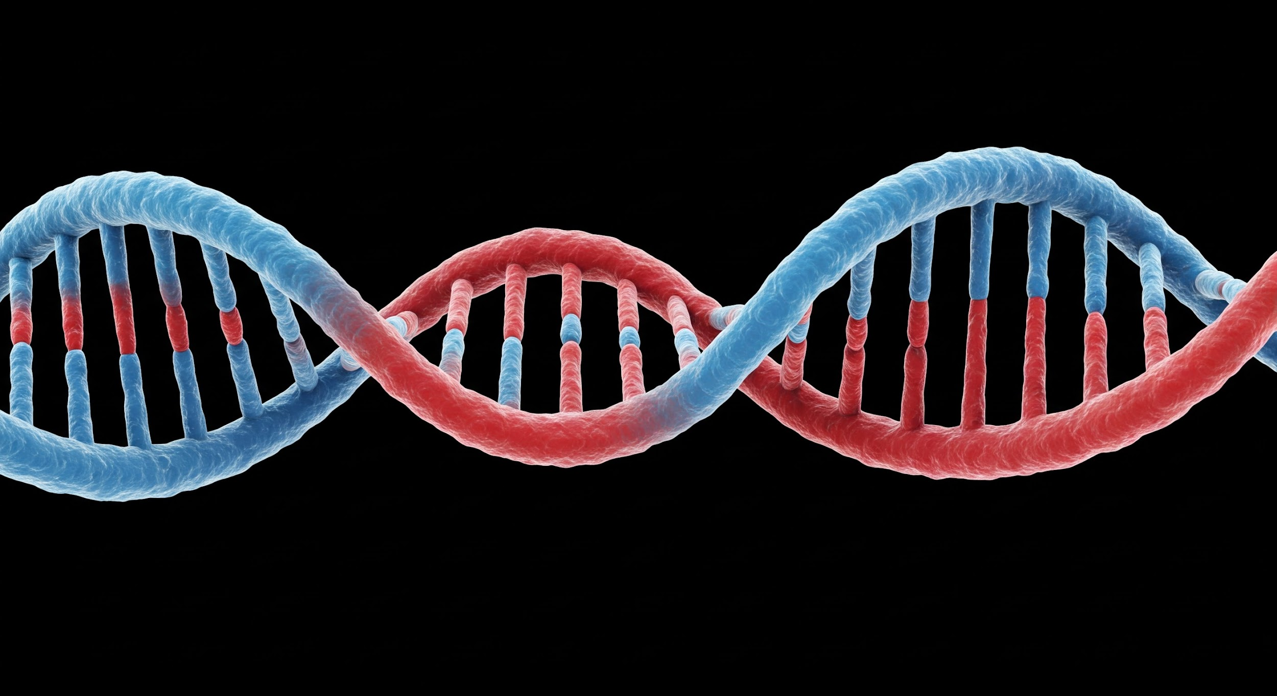
Thank You

